Slide 1

2026 Exhibitor Meeting

Slide 2
















DIAMOND SPONSOR
PLATINUM SPONSOR
GOLD SPONSORS
SILVER SPONSORS
BRONZE COFFEE BREAK SPONSORS

Slide 3

2026 Keynote Speaker
James Tour
Ph.D., FRSC, NAI, NAE
Rice University

Slide 4

2027 Conference Dates
October 12-13th
Moody Gardens Convention Ctr
Galveston, TX 77554

Slide 5
Conference Registration 2026
Total Registrations:TBD
Attendees: TBD
Exhibits Only: TBD
Exhibitors: TBD
Students: TBD
Exhibiting Companies:153
Booths Sold:234

Slide 6
GCC Past Attendance
 | Exhibitors | Attendees | Expo Only | Students
2013-MG | 742 | 698 | 502
2014-MG | 886 | 816 | 588
2015-NRG | 982 | 708 | 543
2016-GRB | 863 | 641 | 586
2017-GRB | 850 | 671 | 354
2018-MG | 733 | 726 | 412
2019-MG | 789 | 688 | 341 | 8
2021-MG | 646 | 455 | 215
2023-MG | 770 | 622 | 313
2024-MG | 799 | 814 | 346 | 11
2025-MG | 753 | 791 | 117 | 23

Slide 7














New Product Showcase Entries

Slide 8
2026 New Product Showcase Winner
TBD
$100 Gift Card Winner - TBD

Slide 9
Booth Prices for 2027
Sign Up For Your Booth Today – Don’t Miss Out on The Discounted Rate!
October 2026
$1795 per booth
Plus 10 VIP passes per booth
May retain current booth space or move to new location if not currently retained by exhibitor from this year.
December 2026
$1895 per booth
Plus 5 VIP passes per booth
November 2026
$1995 per booth
Jan. – Oct. 2027
$2095 per booth

Slide 10




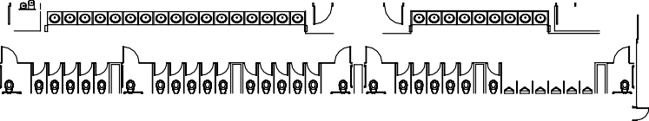


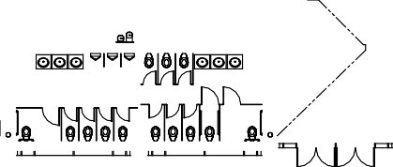
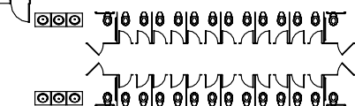


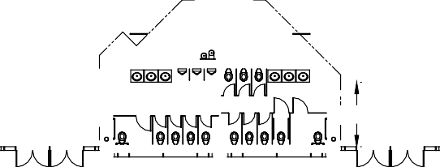
AMP DN.
OPE: 1:20

Slide 11
THANK YOU
GCC 2026 TECHNICAL ADVISORY COMMITTEE
CHAIRPERSON:
Jean-Francois Borny, Lummus Technology
• Poulami Dutta – Dow Chemical
• Rudy Haas, HORIBA Instruments, Inc.
• George Gonzalez, Agilent
• Jamie Nossal, Nossal Consulting, LLC
• Jonathan Richter, DataCor
• Raj Shah, Koehler Instruments
• Bill Winniford, Dow Chemical (Retired)

Slide 12







Gulf Golf Tournament Sponsors
Diamond Golf Sponsor
Platinum Golf Sponsors
Silver Golf Sponsors
Gold Golf Sponsors
Bronze Golf Sponsors

Slide 13



A Big Thank You To Our Golf Committee
Bob Stamp
Rudy Haas
Paul & Laura Stankiewicz

Slide 14
Presenter of the Year Award – Coming Soon
2025 BINGO Winners
1. TBD - $150
2. TBD - $350
3. TBD - $500

Slide 15
Got Questions/Comments?
Email Anita
Ametcalf@GulfCoastConference.com

