Slide 1

2025 Exhibitor Meeting

Slide 2














DIAMOND SPONSOR
PLATINUM SPONSOR
GOLD SPONSORS
SILVER SPONSORS
BRONZE COFFEE BREAK SPONSORS

Slide 3

2025 Keynote Speakers
Petr Vozka
Associate Professor of Chemistry and Biochemistry
California State University, Los Angeles
● Marty Dytrych
● Business Development Manager ● Bolo AI

Slide 4

2026 Conference Dates
October 13-14th
Moody Gardens Convention Ctr
Galveston, TX 77554

Slide 5
Conference Registration 2025
Total Registrations: 1684 Attendees: 791 Exhibits Only: 117 Exhibitors: 753 Students:23
Exhibiting Companies: 158
Booths Sold: 241

Slide 6
GCC Past Attendance
 | Exhibitors | Attendees | Expo Only | Students
2013-MG | 742 | 698 | 502
2014-MG | 886 | 816 | 588
2015-NRG | 982 | 708 | 543
2016-GRB | 863 | 641 | 586
2017-GRB | 850 | 671 | 354
2018-MG | 733 | 726 | 412
2019-MG | 789 | 688 | 341 | 8
2021-MG | 646 | 455 | 215
2023-MG | 770 | 622 | 313
2024-MG | 799 | 814 | 346 | 11

Slide 7











New Product Showcase Entries

Slide 8
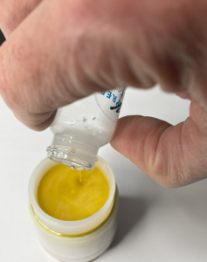

2025 New Product Showcase Winner 2025 Best New Analytical Technique: Oil Solidification Technique $100 Gift Card Winner Heather Cui, Akzo Nobel

Slide 9
Booth Prices for 2026
Sign Up For Your Booth Today – Don’t Miss Out on The Discounted Rate!
October 2025
$1795 per booth
Plus 10 VIP passes per booth
May retain current booth space or move to new location if not currently retained by exhibitor from this year.
December 2025
$1895 per booth
Plus 5 VIP passes per booth
November 2025
$1995 per booth
Jan. – Oct. 2026
$2095 per booth

Slide 10
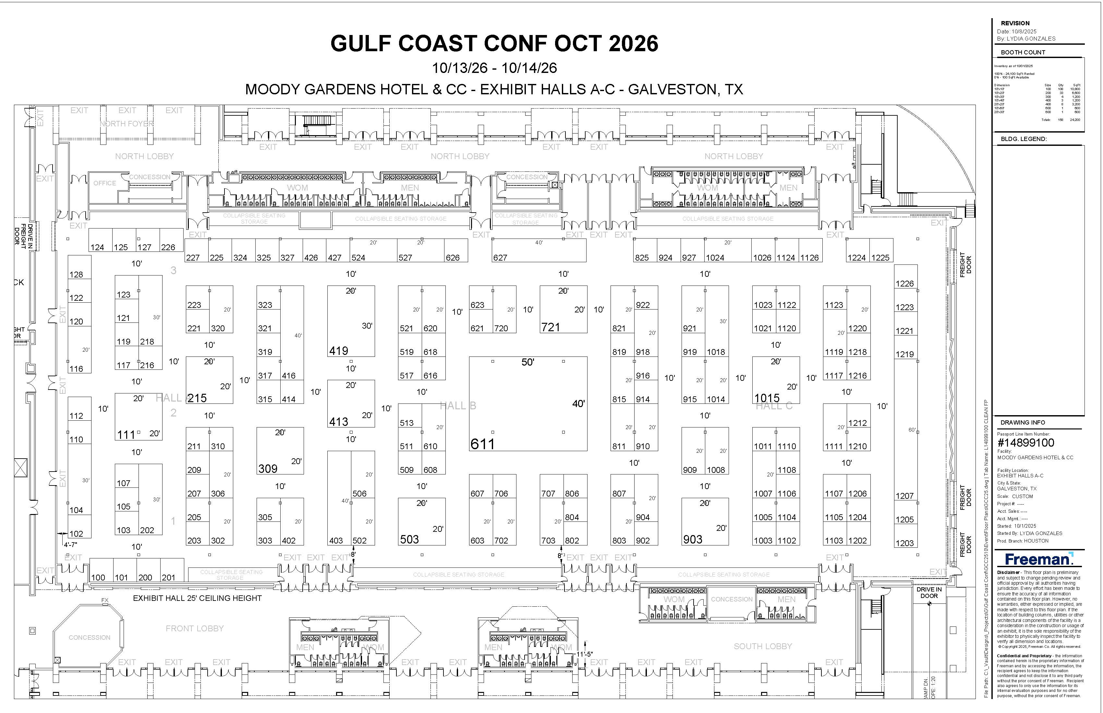

Slide 11
THANK YOU
GCC 2025 TECHNICAL ADVISORY COMMITTEE
CHAIRPERSON:
Jean-Francois Borny, Lummus Technology
• Frank Di Sanzo, ExxonMobil (Retired)
• Poulami Dutta – Dow Chemical
• Rudy Haas, HORIBA Instruments, Inc.
• George Gonzalez, Agilent
• Jamie Nossal, BV Inspectorate America
• Jonathan Richter, Baytek International
• Raj Shah, Koehler Instruments
• Bill Winniford, Dow Chemical (Retired)

Slide 12





Gulf Golf Tournament Sponsors
Diamond Golf Sponsor
Platinum Golf Sponsors
Silver Golf Sponsors
Gold Golf Sponsors
Bronze Golf Sponsors

Slide 13


A Big Thank You To Our Golf Committee
Bob Stamp
Paul & Laura Stankiewicz
Rudy Haas

Slide 14
Presenter of the Year Award – Lee Marotta, PerkinElmer Poster of the Year Award – James Pachlhofer, Thermo Fisher Scientific ABSTRACT #210: Unveiling Microplastics: Precision Analysis Using Py-GCMS Technology
2025 BINGO Winners 1. Gabriel Murillo Morales, Prairie View A&M $150
2. David Aguilar, Chevron $350
3. Anne Maples, MidContinental Chemical $500

Slide 15
Got Questions/Comments?
Email Anita
Ametcalf@GulfCoastConference.com

